Slide 1
IBM Innovation Hackathon 2020
(Cummins College of Engineering for Women)

Slide 2
Introduction
Team Name : RedRangers (Team No.20)
Team Members :
1.Anurag Pandey
2.Hrishikesh Bhattu

Slide 3
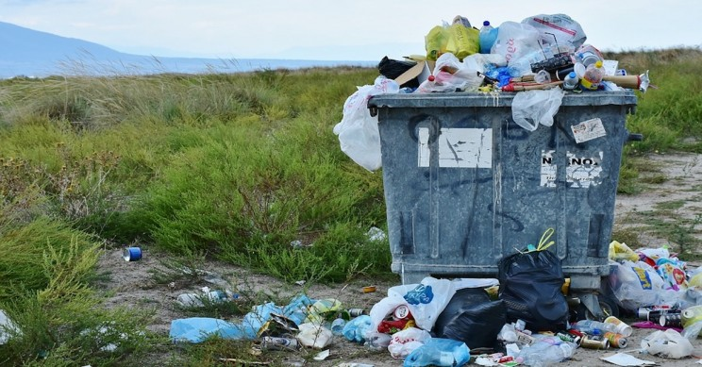
Problem Statement
Proper collection and disposal of plastic wastes.
Reasons:
> No channels for keeping the government accountable.
> Not able to understand the scale at which the plastic pollution is
present.
> Lack of tools for understanding the distribution of wastes.
> Lack of Community Interaction.

Slide 4
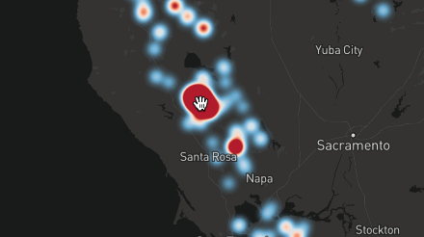

Solution
> Crowdsourcing the data.
> Analyzing the datapoints.
> User understandable representation of datapoints.
> Leveraging Social media.
Credit :Vladimir Agafonkin

Slide 5
Business Model
How to incentivise the user to use our app?
> Shoutouts on social media, to users who contribute on the application
regularly
> Helping the users make their voices heard
> Making them feel to be a part of larger community
> To empower the user to hold the local authorities accountable
How to pitch the application to the respective government
authorities?
> Helping them keep the society clean
> Showing accountability on their side
> Good Public Relations

Slide 6
Demo

Slide 7
Thank You

